Slide 1
Smart Sentence Generator
Navkar Shah (60003160055)
Bhavi Modi (60003178007)
Yash Adke (60003178012)
Project Guides: Dr. Abhijit Joshi
Prof. Lakshmi Kurup

Slide 2
Introduction
The Smart Sentence Generator is a system implemented for helping the students to learn sentence formation and other aspects of English language.
Our system aims at providing the students with a unique way to learn sentence formation and its structure, using correct grammar in the sentences.
It makes use of NLP (Natural Language Processing) based algorithms and libraries for creating these sentences that will vary from simple to compound and complex sentences.

Slide 3
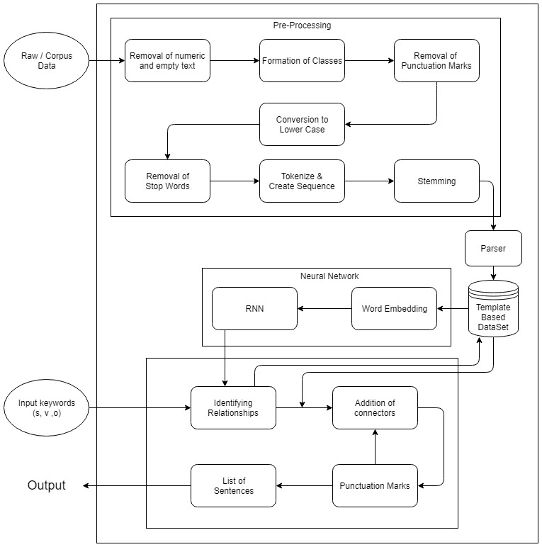
Proposed System Architecture

Slide 4
System Modules
Module 1: Simple Sentence Generation
Using Single subject, verb and object (SVO).
Module 2:Generation of Interrogative Sentences.
Using Question Mark (?)along with SVO.
Module 3:Generation of Exclamatory Sentences.
Using Exclamation Mark(!) along with SVO.
Module 4: Generation of Complex Sentences.
Using Multiple subjects, verbs and objects along with clauses.

Slide 5
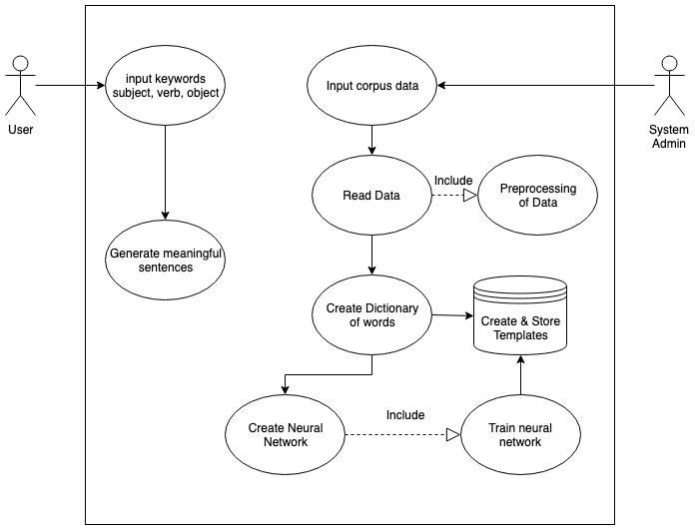
Design Specifications
Use Case Diagram

Slide 6
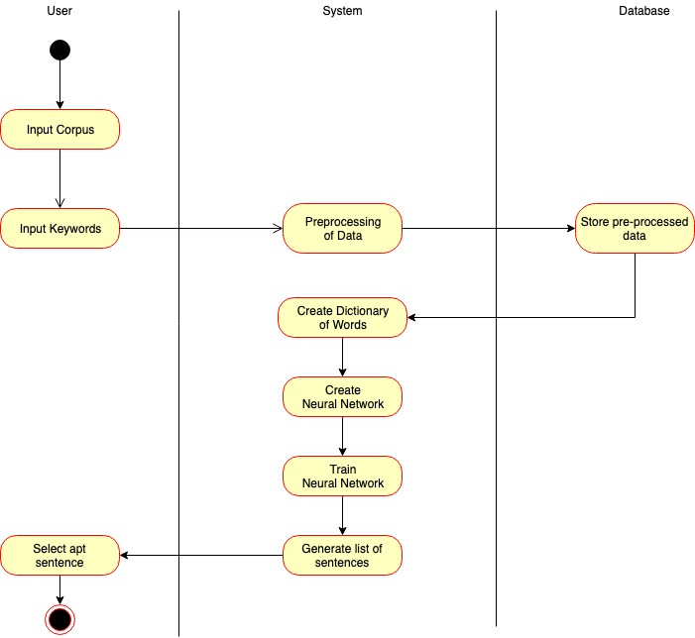
Activity Diagram

Slide 7
Software And Hardware Requirements
Software Requirements :
Technologies : Anaconda, Python
Back End : JSON
Hardware Requirements :
16 GB RAM
GPU

Slide 8
Algorithms And Methodologies
The contemporary algorithms are not able to generate semantically correct sentences, which cannot be used in our sentence generation.
Hence, we created our own database templates that provide a means for relation between different parts of speech.
The algorithm is written to use this templates for generating syntactically and semantically correct sentences.
Gensim Model is to be used for generation of templates as it is primarily used for topic modelling and document similarity. It has word2vec and sentence2vec also implemented.

Slide 9
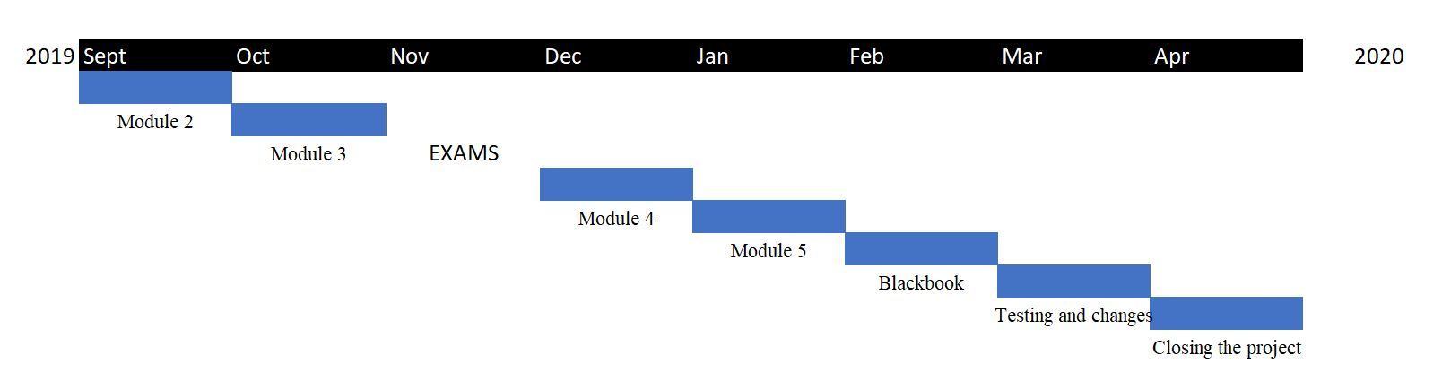
Timeline

Slide 10
Thank You

